Slide 1
A
Fig XX. Sampling & Reporting Strategy
A. A schematic displaying a theoretical change in seroprevalence over the course of a year. Colored regions represent sampling schemes present in filovirus/henipavirus literature. B. Breakdown of sampling schemes present in literature. Includes mean time (in days) and standard deviation over which studies pooled multiple sampling events into single estimate.
B

Slide 2
A
Fig XX. Sampling & Reporting Strategy
A. A schematic displaying a theoretical change in seroprevalence over the course of a year. Colored regions represent sampling schemes present in filovirus/henipavirus literature. B. Breakdown of sampling schemes present in literature. Includes mean time (in days) and standard deviation over which studies pooled multiple sampling events into single estimate.
B

Slide 3
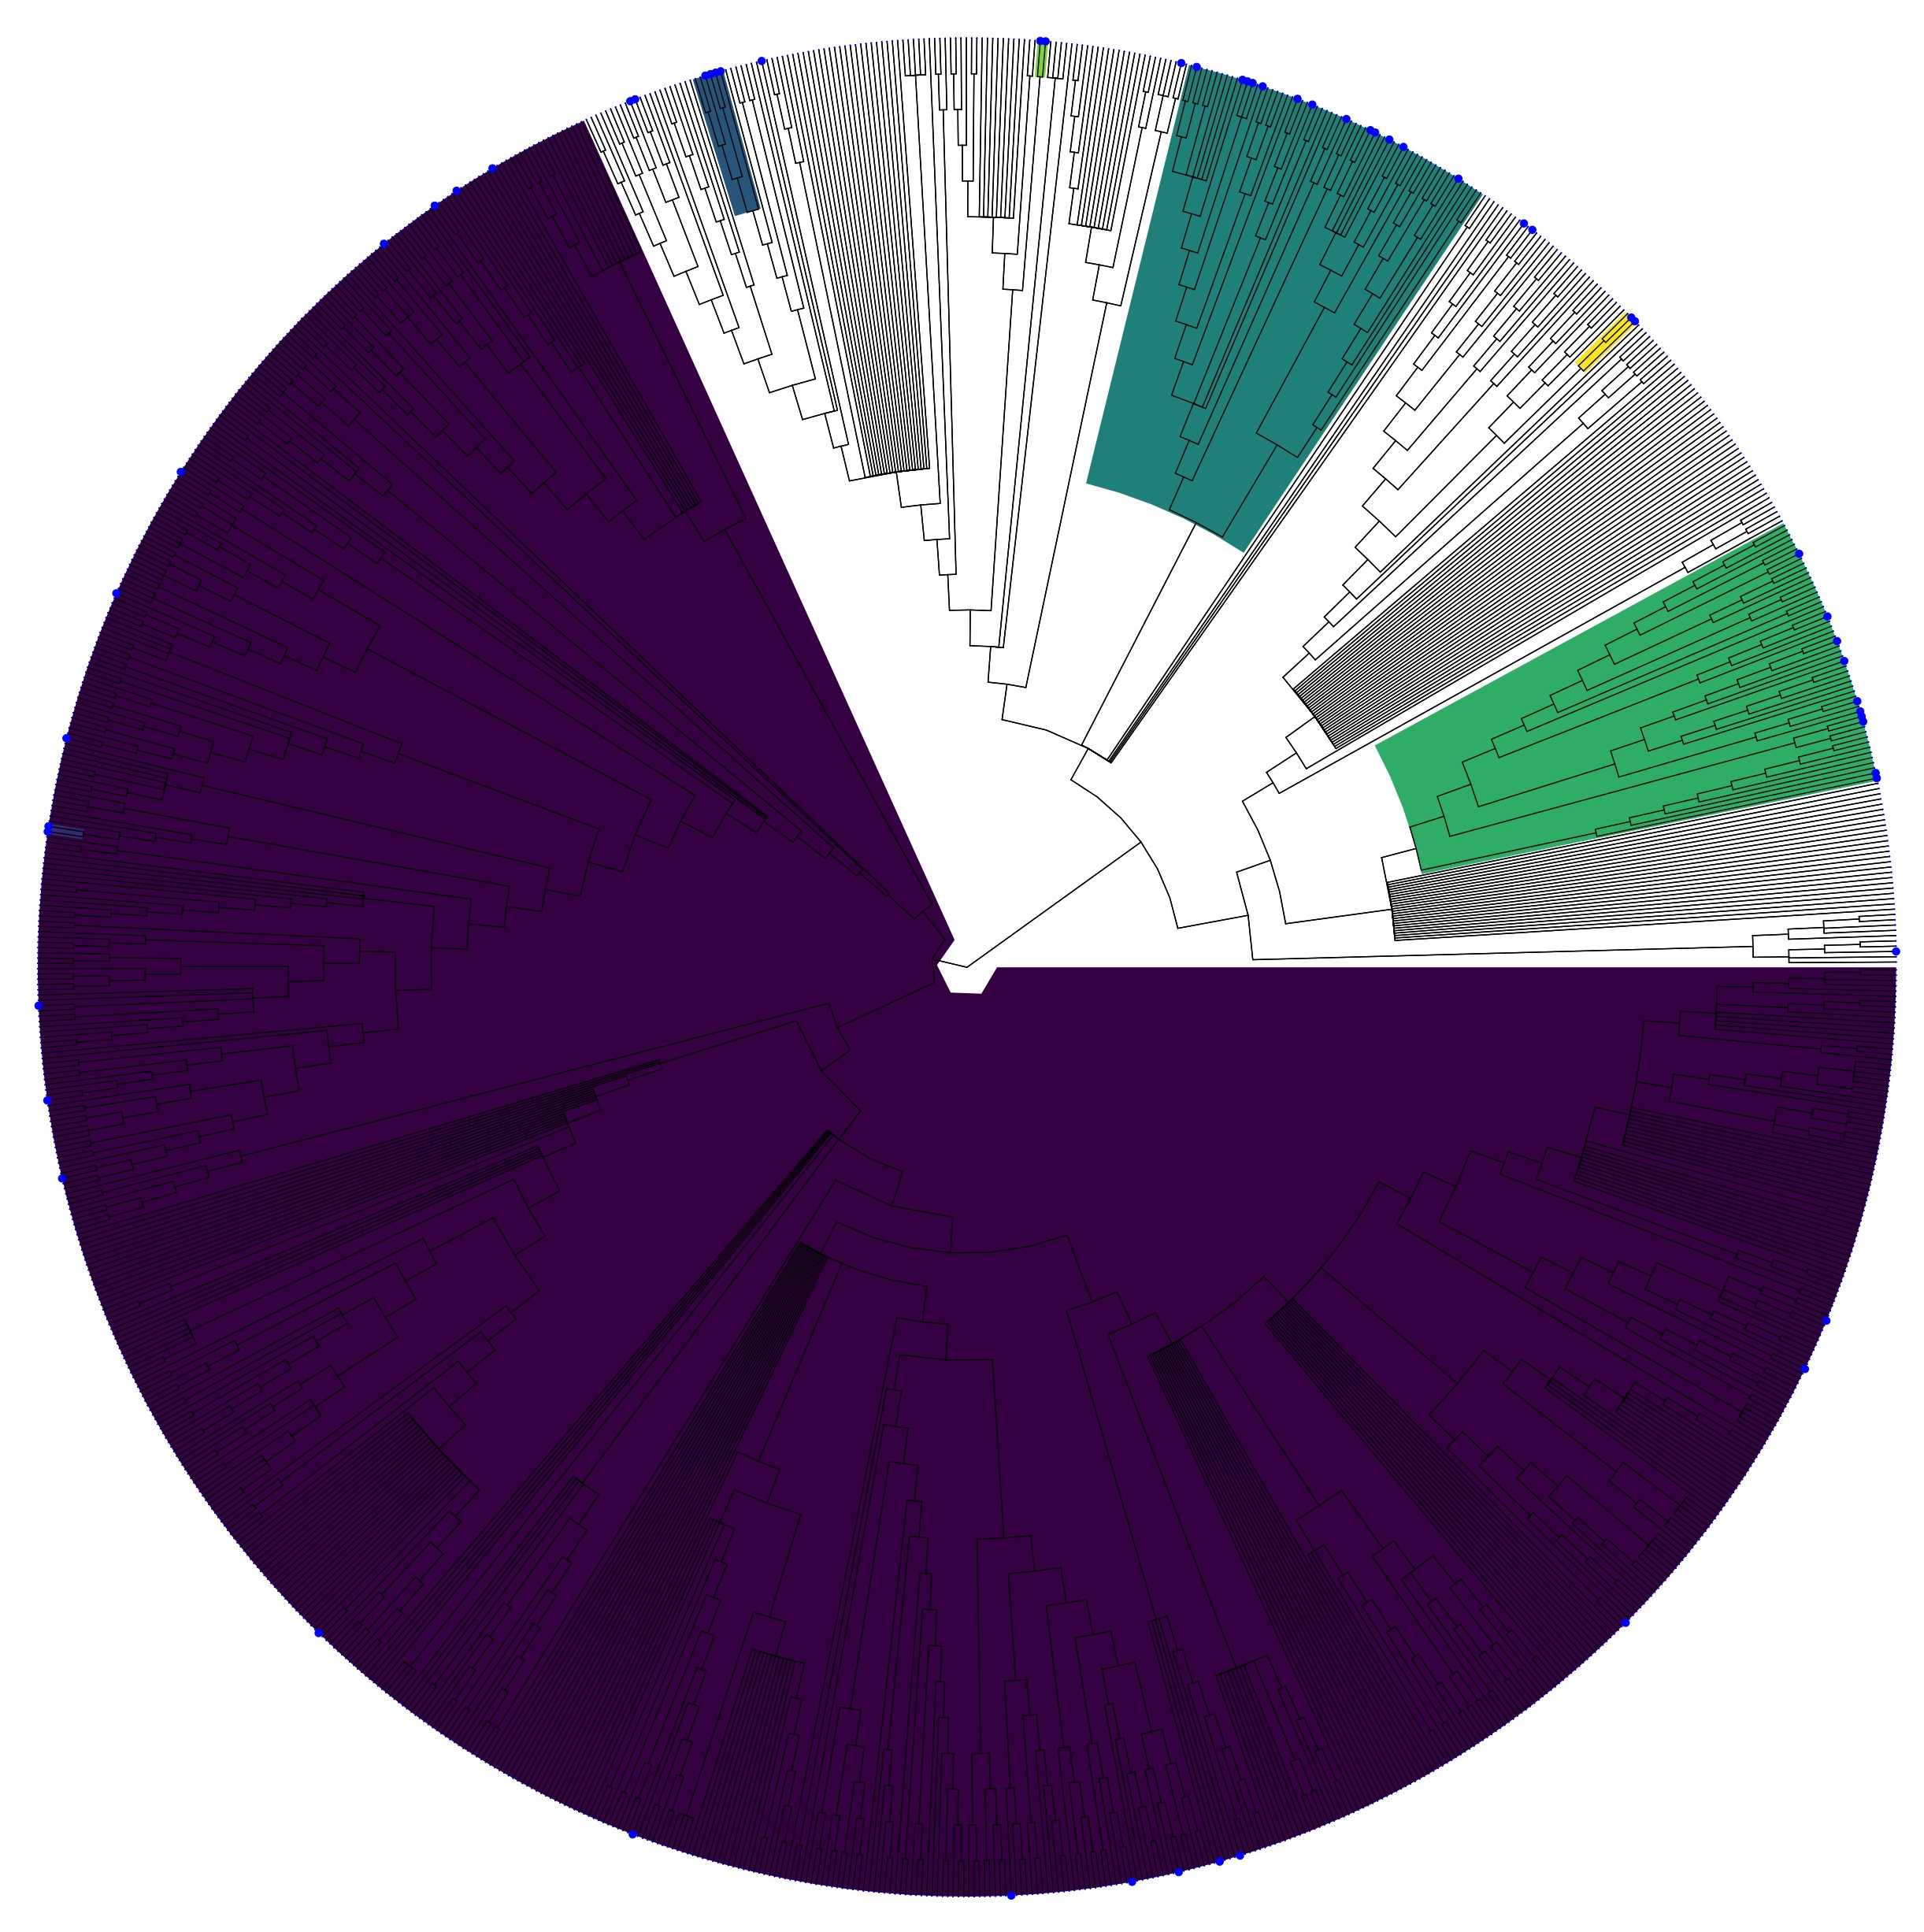
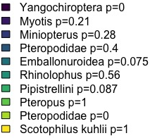
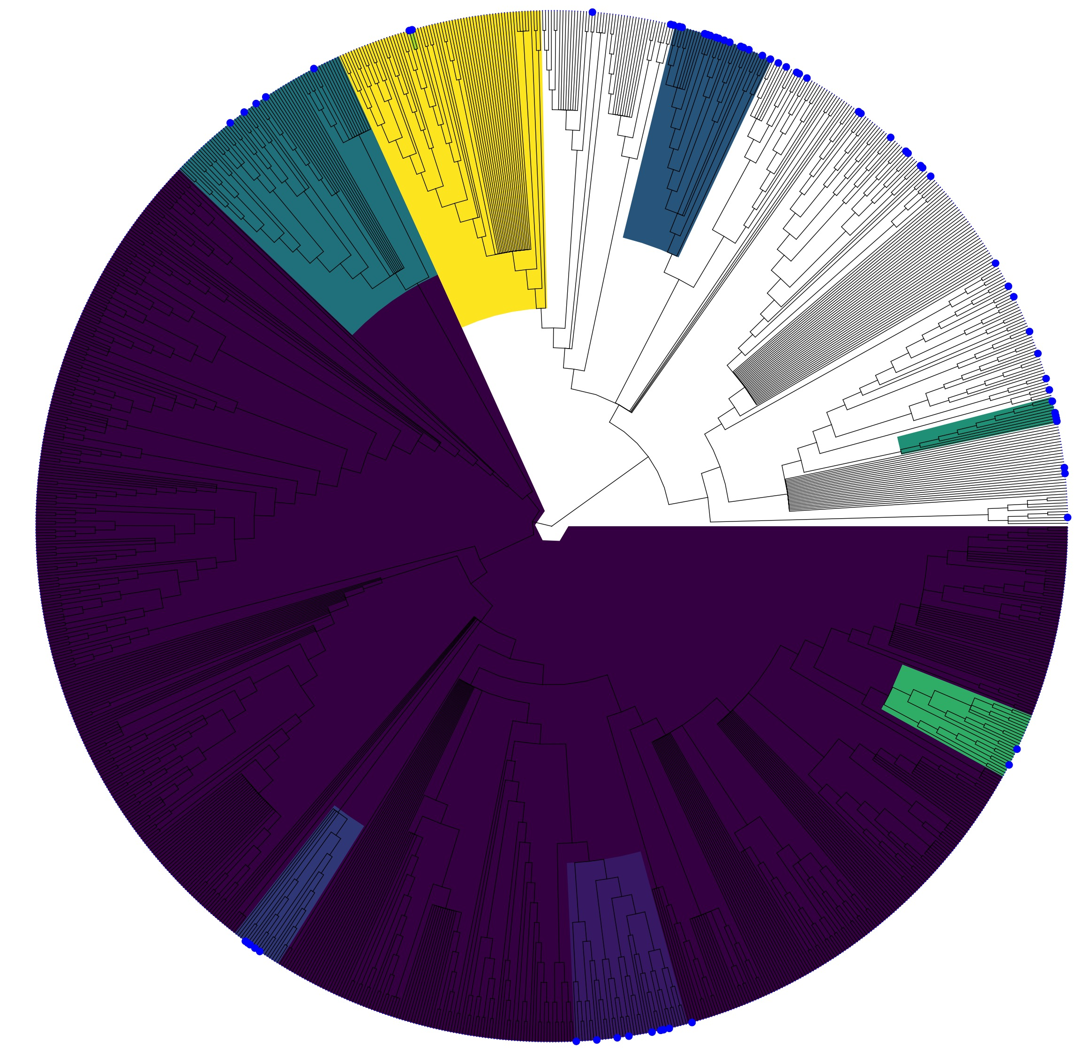
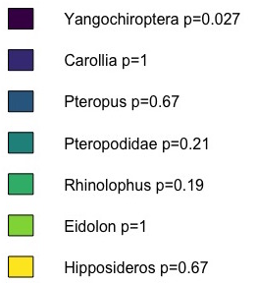
Henipavirus Phylofactor Results
Figure XX. Phylofactorization of the full bat phylogeny. Outcome variable is a binary response for sampling of either Henipavirus or Filovirus.
Filovirus Phylofactor Results

